Slide 1
International Building Code
Apply the rules for height and areas of buildings
Perform calculations related to adjustment factors

Slide 2
Historic Fire
MGM Grand

Slide 3
Height and Area
Sections 504 and 506
Sprinklers generally increase by 20 ft and 1 story for height
Sprinklers add 2 or 3 times original area

Slide 4
Modifications of Area Limits
A_{a}=A_{t}+[A_{t}*I_{f}]+[A_{t}*I_{s}]
or
A_{a}=A_{t}+[NS*I_{f}]
Where:
A_{a}= Allowable area per floor
A_{t}= Allowable area from Table
I_{f}= Area factor increase due to frontage
I_{s}= Area factor increase due to sprinklers

Slide 5
Area factor for sprinklers
I_{s}=3 for buildings one story above ground
I_{s}=2 for buildings more than one story above ground

Slide 6
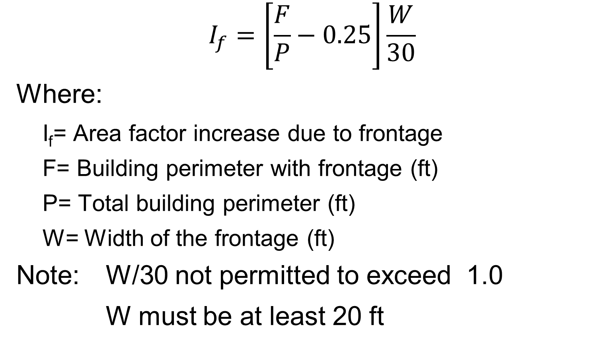
Area Factor for Frontage
$$I_{f}=\left[\frac{F}{P}−0.25\right]\frac{W}{30}$$
Where:
I_{f}= Area factor increase due to frontage
F= Building perimeter with frontage (ft)
P= Total building perimeter (ft)
W= Width of the frontage (ft)
Note: W/30 not permitted to exceed 1.0
W must be at least 20 ft

Slide 7
Area Factor for Frontage
New table values in 2021
New values are at the lower end of each range
Interpolation allowed
Client will want you to use linear interpolation
Old equation was linear interpolation
All values are still the same
% of Perimeter | Open Space <20 ft | Open Space 20 to <25 ft | Open Space 25 to <30 ft | Open Space 30 ft or more
<25 | 0 | 0 | 0 | 0
25 to <50 | 0 | 0.17 | 0.21 | 0.25
50 to <75 | 0 | 0.33 | 0.42 | 0.50
75 or greater | 0 | 0.50 | 0.63 | 0.75

Slide 8
Example 1
What are the height and area limitations for a Group M occupancy in a building of Type III B construction?
Solution: 2 Stories, 12,500 ft² per floor.

Slide 9
Example 2
What are the height and area limitations for a library in an unprotected steel building without sprinklers?
Solution: 2 Stories, 9,500 ft² per floor

Slide 10
Example 3
Are the height and area of the building acceptable?
Building is unsprinklered
Frontage on two adjacent sides 25 feet wide
2 Stories
110 ft x 100 ft
Type V-B Construction
Group B occupancy

Slide 11
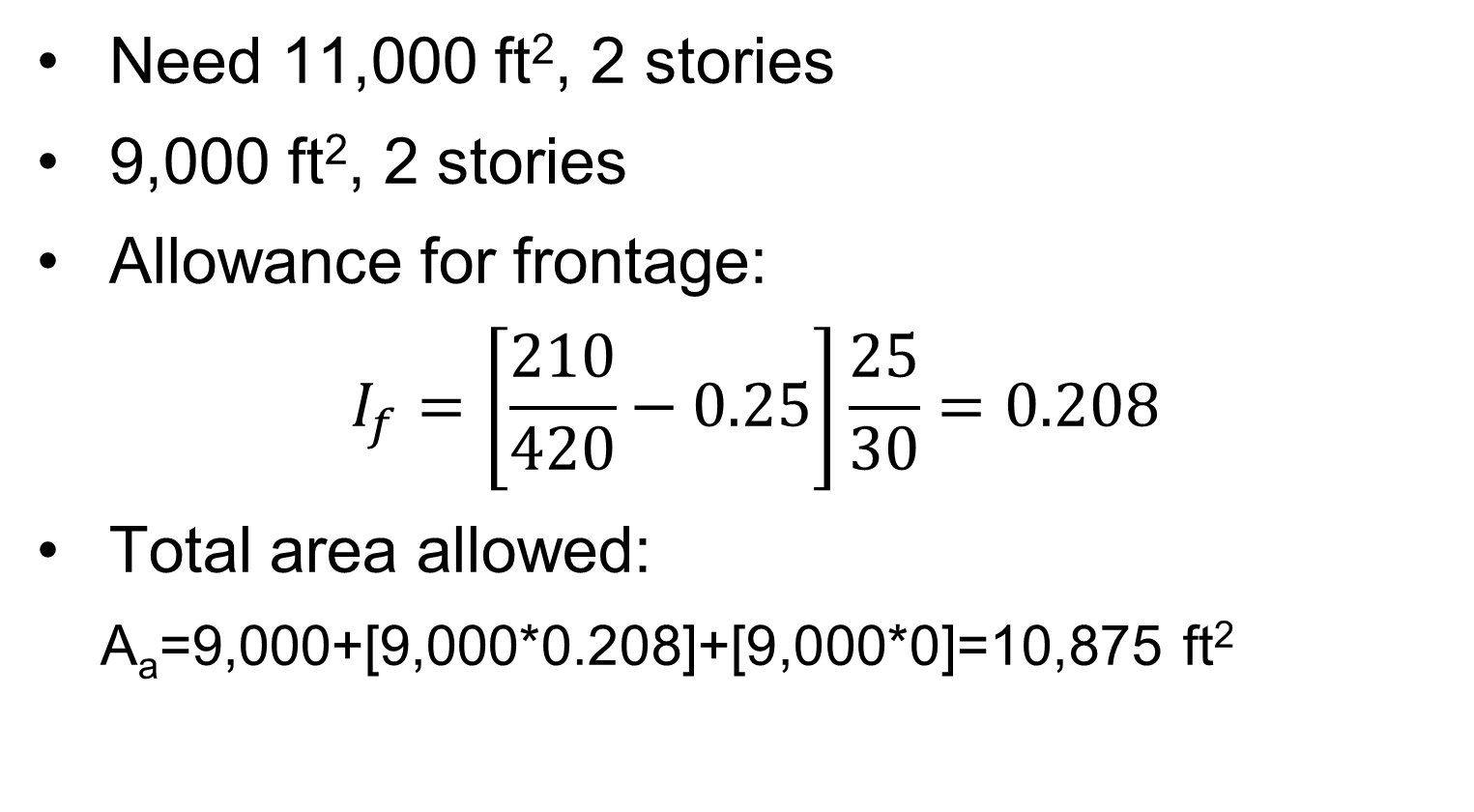
Example 3
Need 11,000 ft², 2 stories
9,000 ft², 2 stories
Allowance for frontage:
$$I_{f}=\left[\frac{210}{420}−0.25\right]\frac{25}{30}=0.208$$
Total area allowed:
A_{a}=9,000+[9,000*0.208]+[9,000*0]=10,875 ft²

Slide 12
Example 3
Options
Just tell the owner no
Ask the owner to make their building smaller
Relocate building on site to increase frontage
Change to different construction type
Protect structural elements
Change material
Add sprinklers

Slide 13
Example 4
Are the area and height acceptable if frontage 30 ft wide exists on all sides?
Sprinklered
3 Stories
130 ft x 360 ft
Group E Occupancy
Type II B Construction

Slide 14
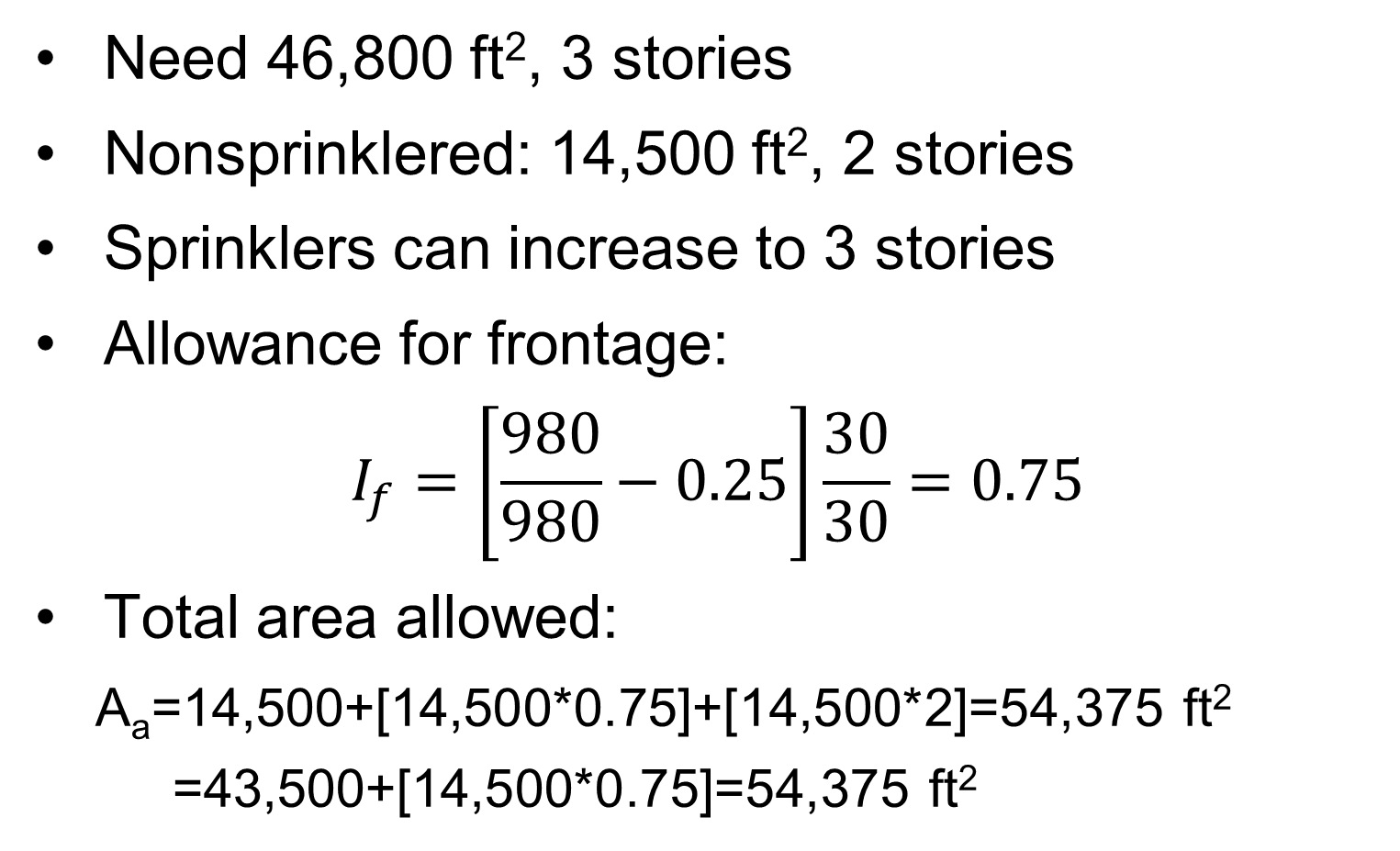
Example 4
Need 46,800 ft², 3 stories
Nonsprinklered: 14,500 ft², 2 stories
Sprinklers can increase to 3 stories
Allowance for frontage:
$$I_{f}=\left[\frac{980}{980}−0.25\right]\frac{30}{30}=0.75$$
Total area allowed:
A_{a}=14,500+[14,500*0.75]+[14,500*2]=54,375 ft²
=43,500+[14,500*0.75]=54,375 ft²

Slide 15
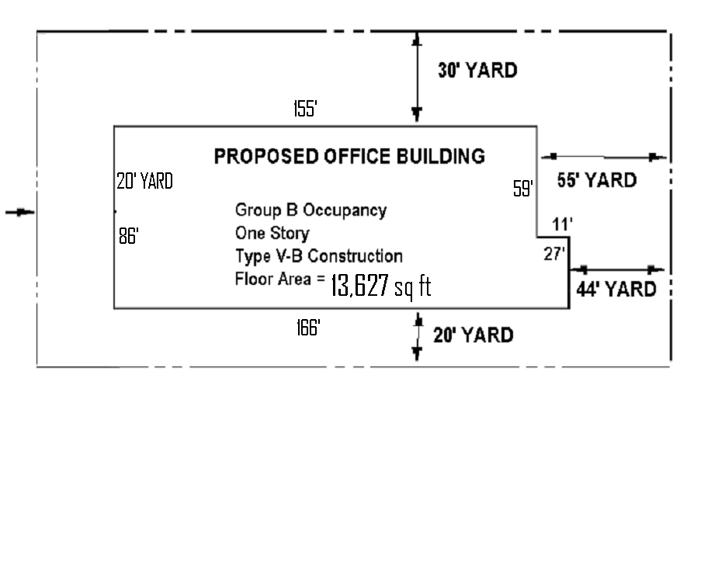
60 ‘ Street
Using the information given, determine if the building may be of Type V-B Construction as proposed
Street 60 Feet Wide

Slide 16
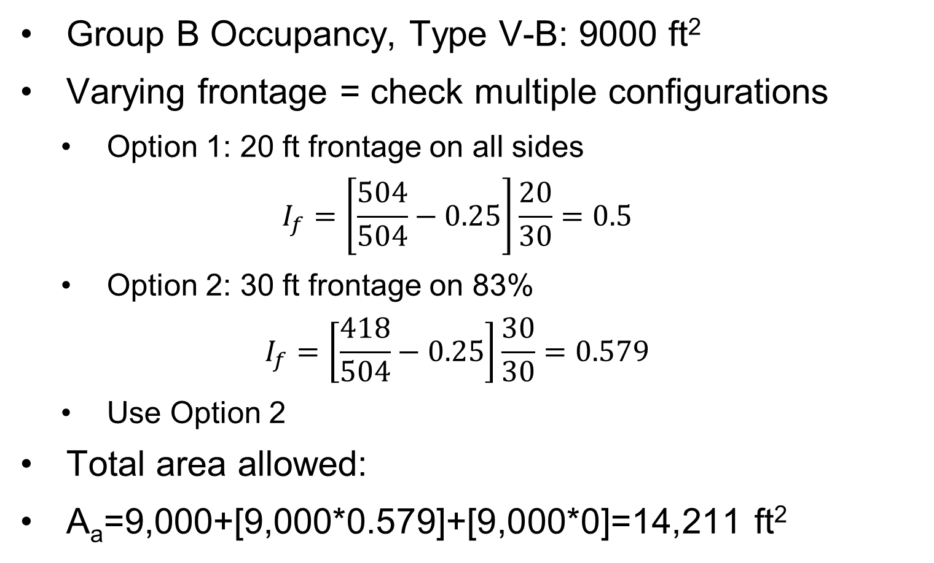
Example 5
Group B Occupancy, Type V-B: 9000 ft²
Varying frontage = check multiple configurations
Option 1: 20 ft frontage on all sides
$$I_{f}=\left[\frac{504}{504}−0.25\right]\frac{20}{30}=0.5$$
Option 2: 30 ft frontage on 83%
$$I_{f}=\left[\frac{418}{504}−0.25\right]\frac{30}{30}=0.579$$
Use Option 2
Total area allowed:
A_{a}=9,000+[9,000*0.579]+[9,000*0]=14,211 ft²

